Slide 1
Insurance Management System Under Dr. Mamatha H R
By:
Kaustubh Jha PES1201700040
Tushar Raj PES1201700221
Sulabh Mittal PES1201700264

Slide 2
Abstract
The insurance management project manages all policies done by agents, brought by customers, maintains details of policies sold by insurance company and it also maintains details of company’s customer and agents.
The customer can view his policies, make corresponding payments, and even see the status of his/her claims and he also needs to maintain his basic information.
Agents can see their salary, commission based on number of policies done and can also see the details of policies sold along with all the details.
Web interface makes managing all these things easy.

Slide 3
Case Study
We have made Insurance Management System hence our case study is ICICI Lombard insurance company.
The ICICI Lombard website is much more complex than what we have done as our project.
Multiple Shortcomings :
Customers can not see the specifications of the policies sold, they can only see the list of policies.
Customers can pay any amount of premium as it is neither stored in the database nor checked from it.

Slide 4
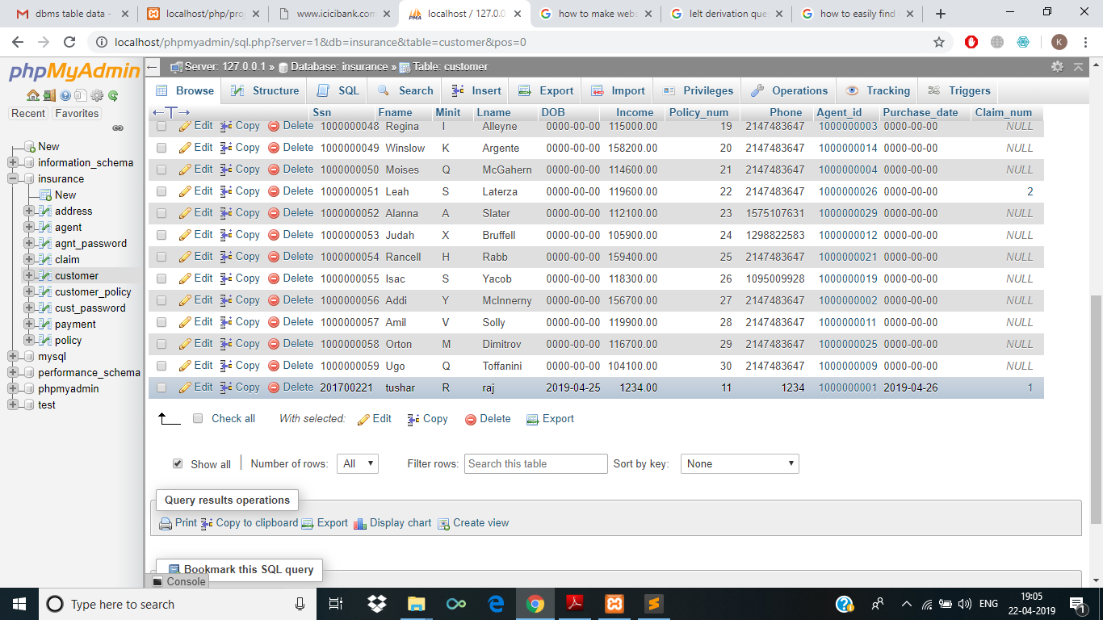
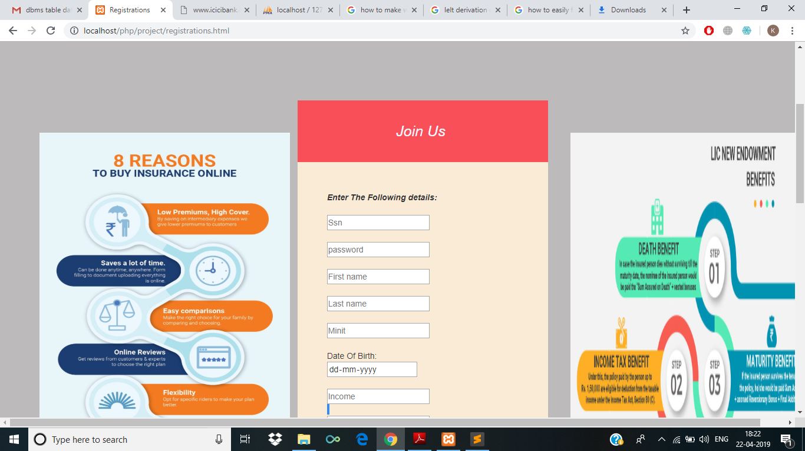
Registration of User
To register a user you have to go to Our services -> register now .
Upon registering you will be asked to fill your details along with the password , and after registering you will be directed to successful login page .
The data separately added into three different tables customer ,cust_password and agent respectively.
Then the number of policies done by the agent gets updated in the database.

Slide 5
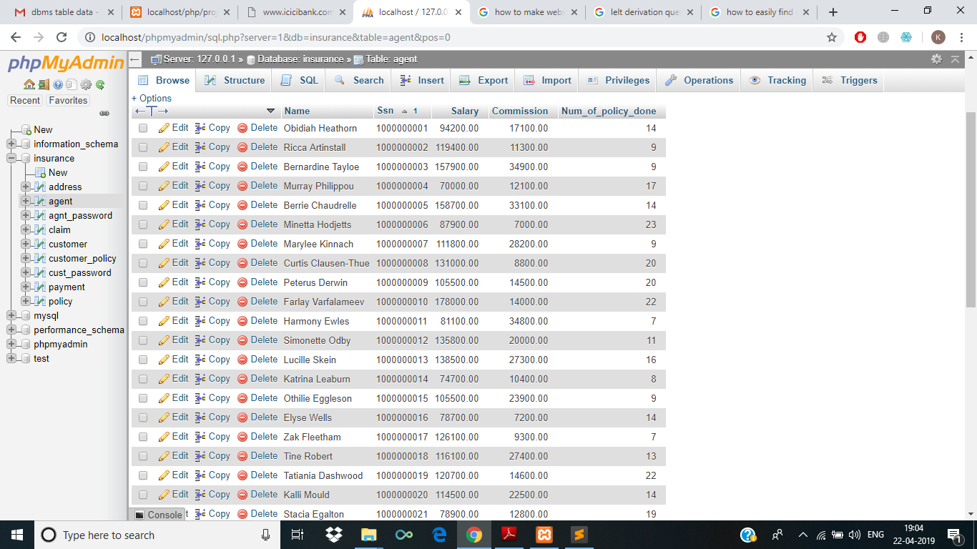

Slide 6
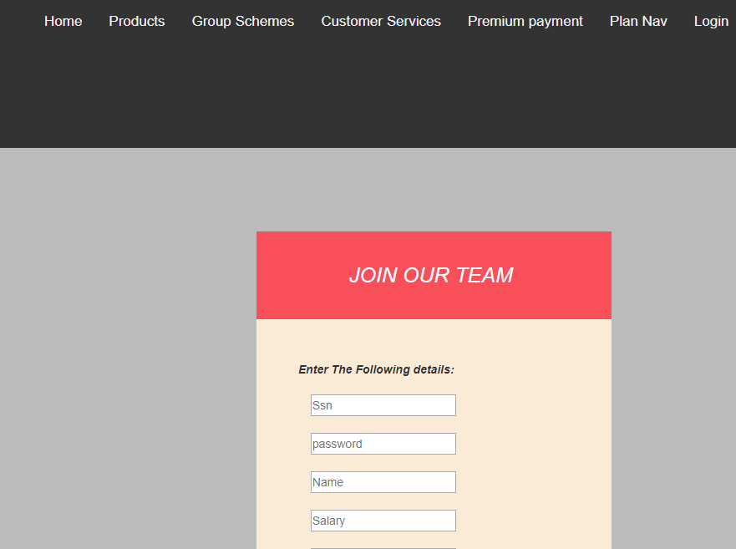
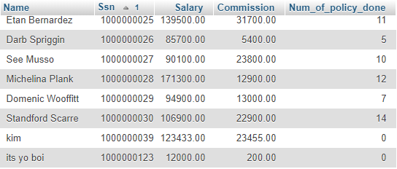
Registration of Agent
To register a user you have to go to Our services -> Join out team.
Upon registering you will be asked agent will be asked to fill the details along with the password , and after registering you will be directed to successful registeration page .
The data separately added into two different tables agent and agent_password.
Once the record has been added number of policies done by that agent gets set to 0 in database.

Slide 7
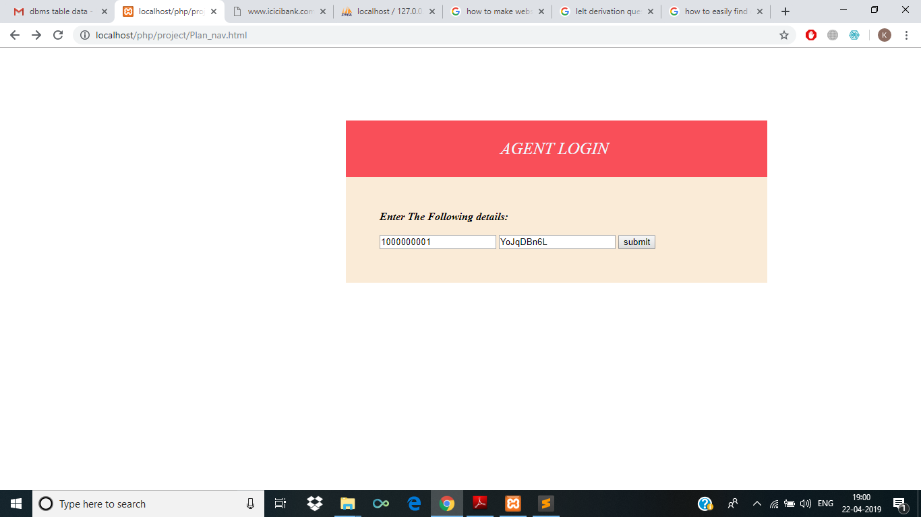
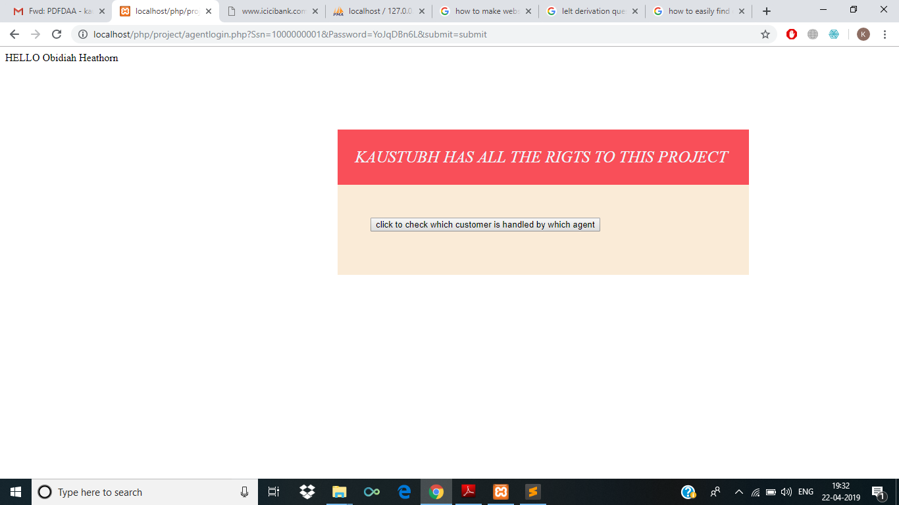
Plan Nav(complex query)
Plan nav is for all the agents to register.
Once the agent has registered you can see which customer is handled by which agent.
Upon further changing we can change the values in the database so to change the customer handled by

Slide 8
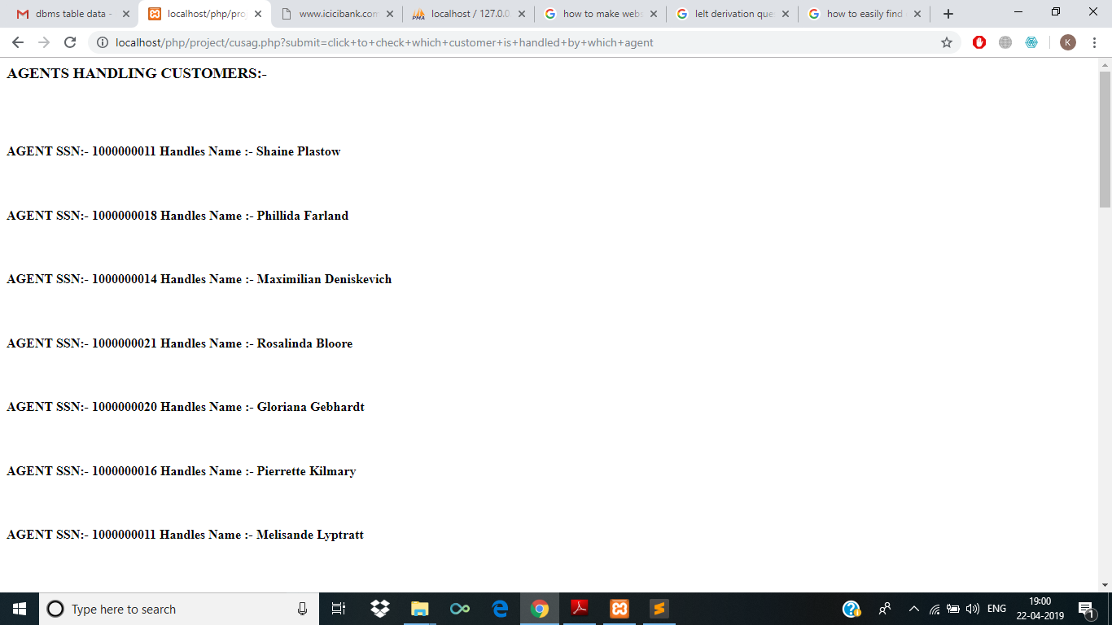

Slide 9
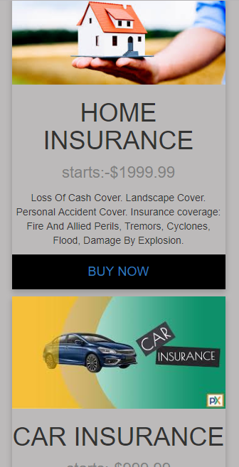
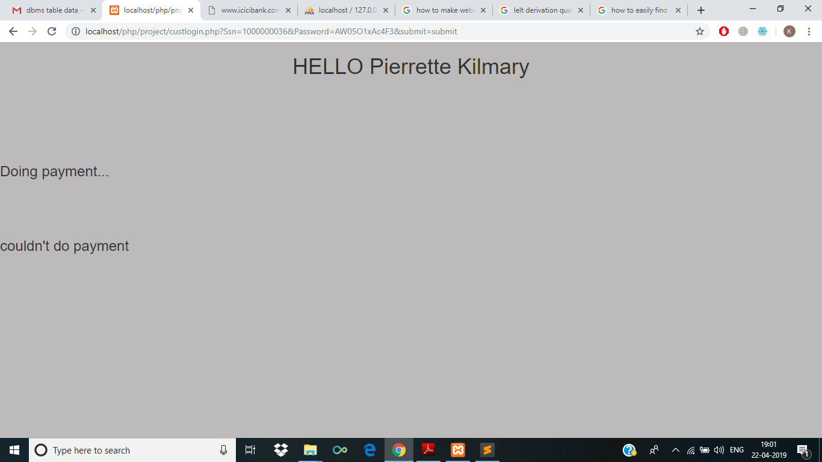
Buy Policies (complex query)
Customer can buy either car or home policy .
Upon selecting which policy to buy you will be directed to customer details page.
Following data will be added when you do the payment on counter to the customer_policy , payment and policy.

Slide 10
Best Employee (complex query)
After customer has logged in he can check who is the best Employee of the month.
Clicking on the link will direct you to the Complex query page that shows you number of policies done by a particular agent.

Slide 11
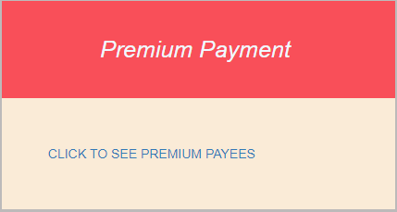
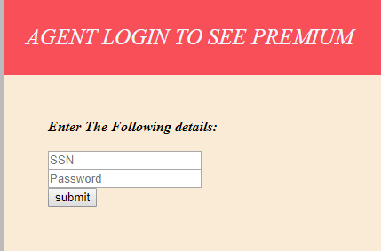
Premium Payment (complex)
Only Agents can see who has done premium payments ,
Upon logining you will be directed to premium payments page which uses a complex query to show how many customers have done premium payments(more than two payments)
For any coherent policy consideration they will be given discount.

Slide 12
Problems with DB and Solution
Problems with DB
Premium payed by customers is not checked in the database, they can pay any amount of premium.
Customers can also not see the requirements of different policies.

Slide 13
Thank You

